Slide 1
Distributed Algorithms
Antonio A. F. Loureiro
Ítalo F. S. Cunha

Slide 2
Antonio A. F. Loureiro
loureiro@dcc.ufmg.br
ICEx 7330
PhD ← 1995, titular, 1A
Research
Wireless networks
Sensor networks
Vehicular networks
Internet of things
Sensoring
Data fusion
Information retrieval
Ubiquitous computing

Slide 3
Ítalo F. S. Cunha
cunha@dcc.ufmg.br
ICEx 6324
PhD ← 2011, UFMG ← 2012
Interest areas
Computer networks
Distributed algorithms and systems
Operating systems
Research
Internet (routing, monitoring, and security)
Media distribution (workload, peer-to-peer)

Slide 4
Course objectives
Provide techniques to investigate properties of distributed algorithms
Provide insight on impossibilities in different scenarios (networks and failures)
Present a collection of useful algorithms
Provide techniques to analyze and solve problems in distributed systems

Slide 5
Examples of distributed systems
Facebook, Google, Netflix, …
Tens of servers and hundreds of processes
Uber, WhatsApp, Waze, …
DotA, WoW, MineCraft, Pokémon Go, …
Interactive, shared data, real-time
Sensoring, autonomous vehicles, IoT
Internet routing, P2P media distribution

Slide 6
Examples of distributed systems
Facebook, Google, Netflix, …
Tens of servers and hundreds of processes
Uber, WhatsApp, Waze, …
DotA, WoW, MineCraft, Pokémon Go, …
Interactive, shared data, real-time
Sensoring, autonomous vehicles, IoT
Internet routing, P2P media distribution
Concepts are widely applicable

Slide 7
Subject matter
Classes discuss main points
Definitely not the whole story
Readings will be announced in advance
Discussion and questions are welcome

Slide 8
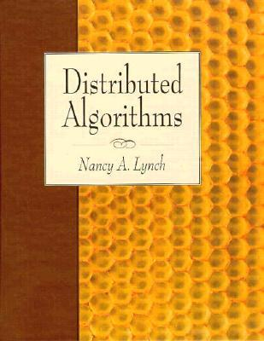
References
Nancy A. Lynch; Distributed Algorithms; Morgan Kaufmann
Complementary material as needed

Slide 9
Grading
Two tests (40%)
Two take-home tests (20%)
Programming assignments (40%)

Slide 10
Collaboration policy
Healthy collaboration is incentivized
Brainstorming about and discussing problems
Plagiarizing code and submitting solutions by other people is not allowed
May interview students on take-home tests and programming assignments

Slide 11

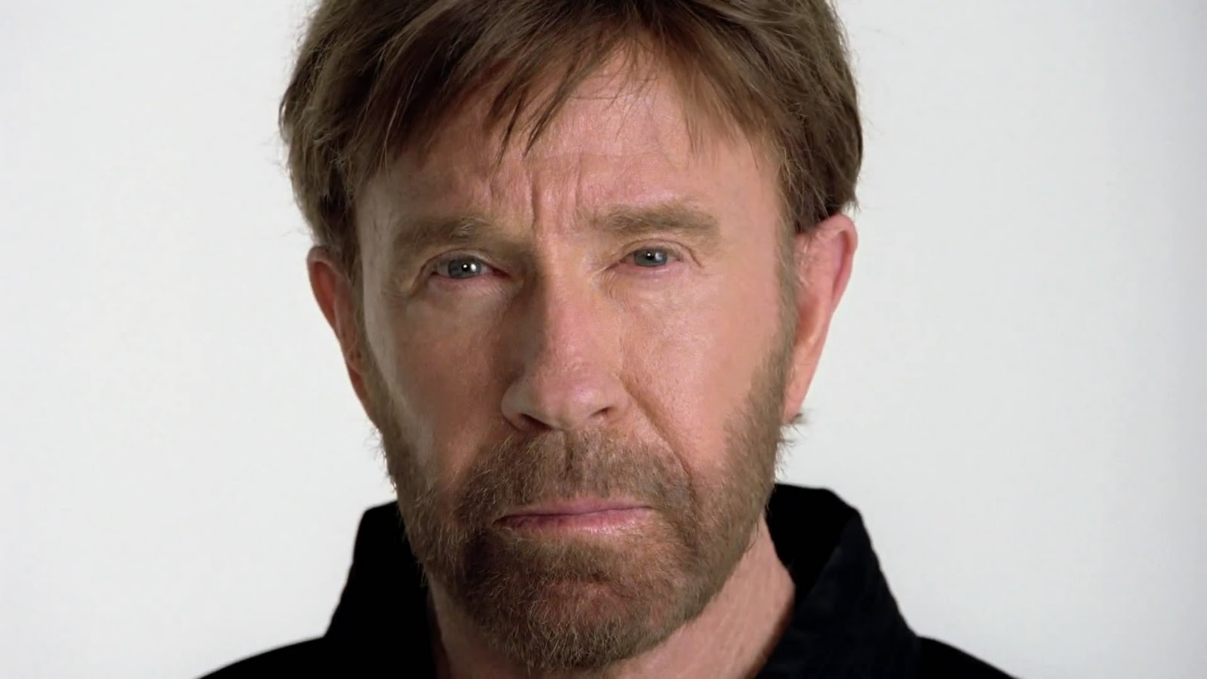
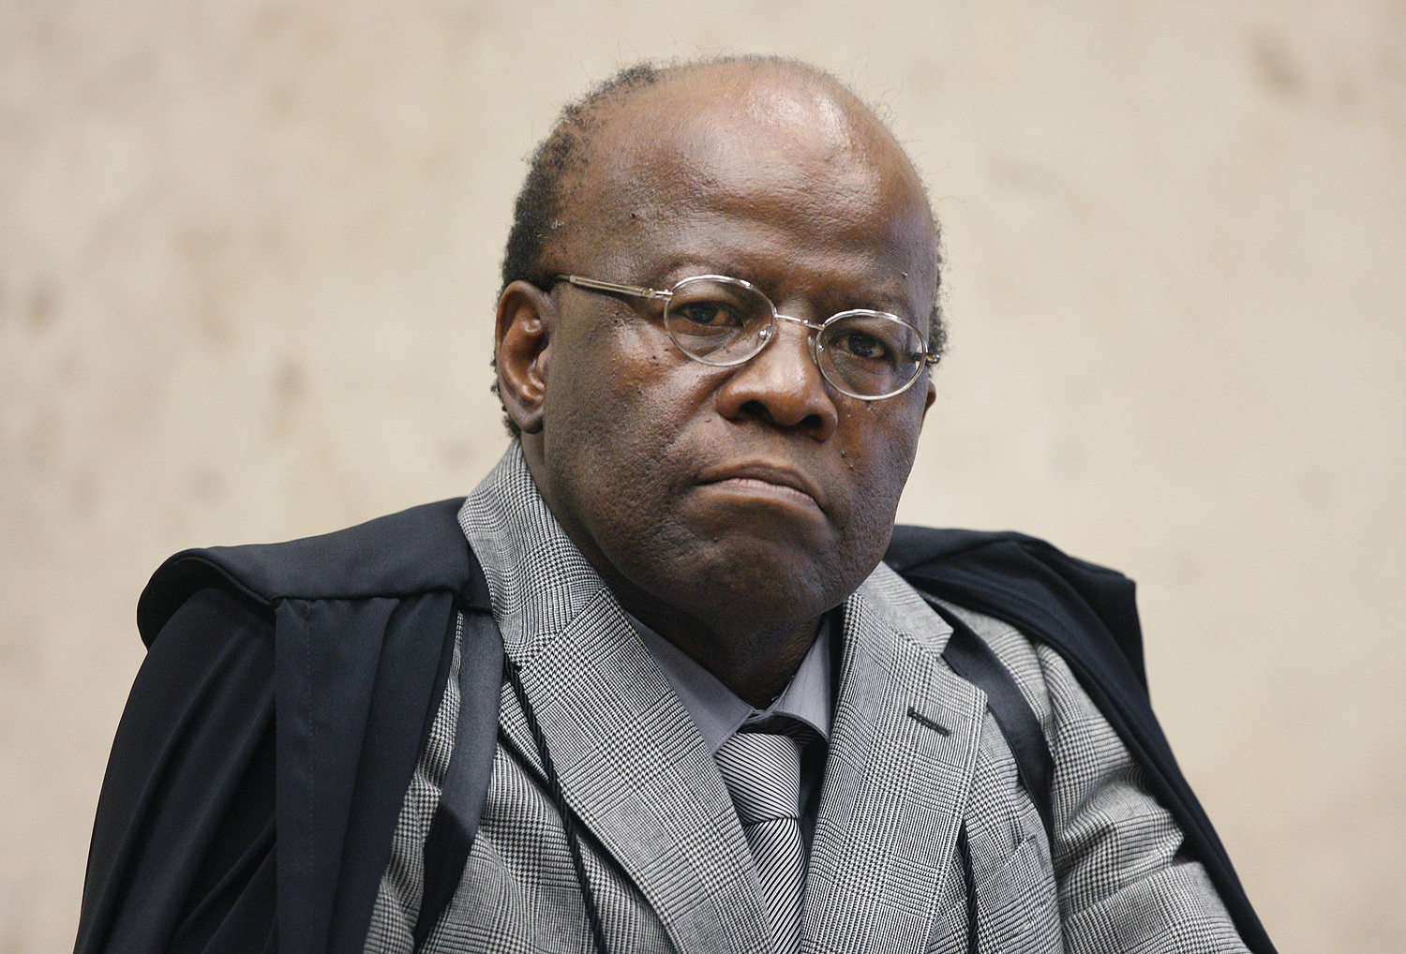
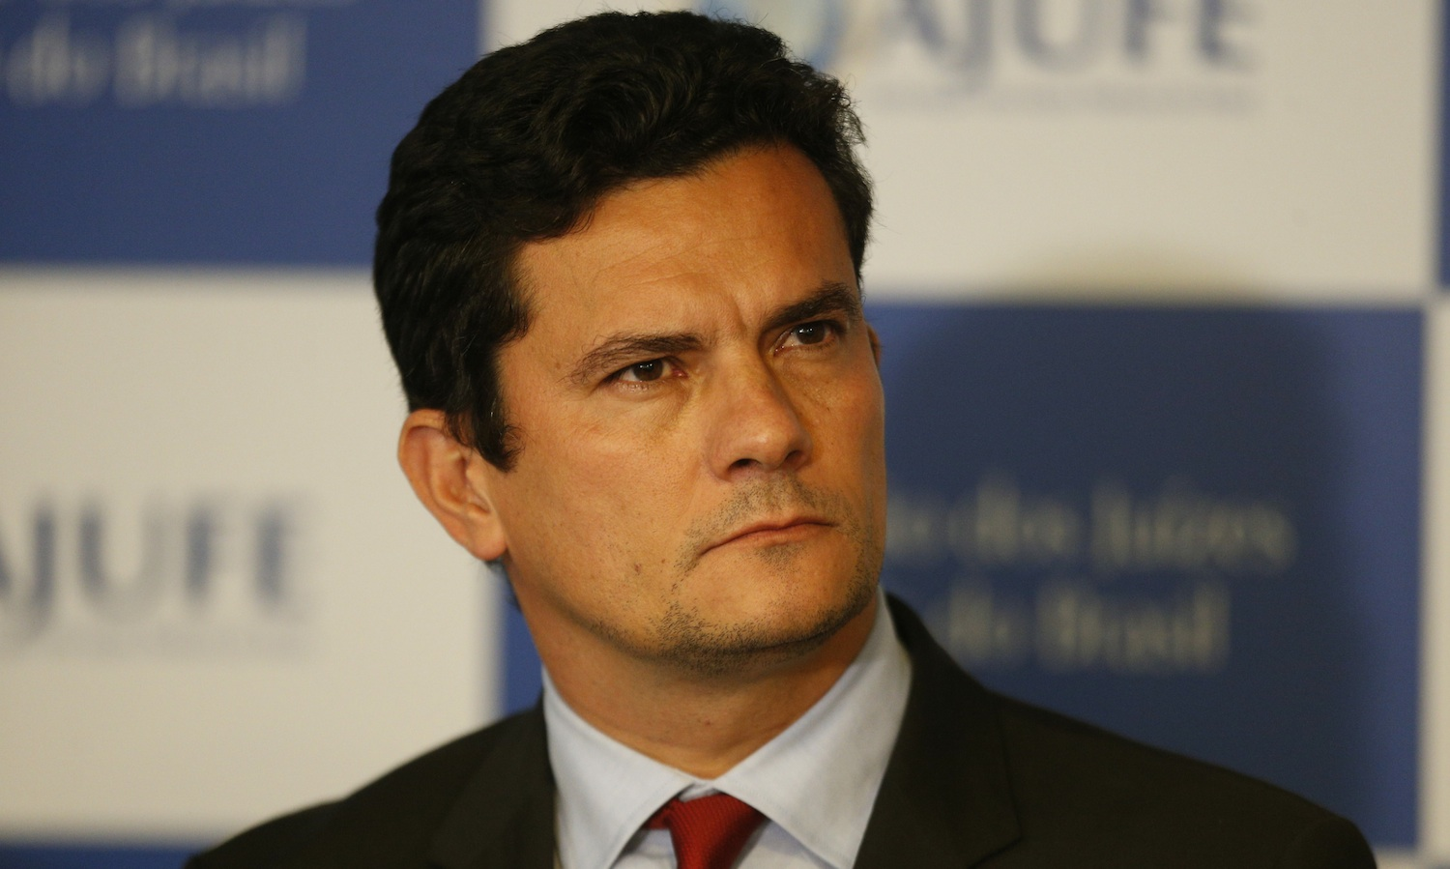
Collaboration policy
Healthy collaboration is incentivized
Brainstorming about and discussing problems
Plagiarizing code and submitting solutions by other people is not allowed
May interview students on take-home tests and programming assignments

Slide 12
Suggestions welcome
The earlier the better

